Slide 1

South Central Economic Development District

Slide 2
Community Development Block Grants For Housing
Housing grants support rehabilitation of owner- and renter-occupied residences within targeted areas to encourage neighborhood revitalization. These rehabilitation funds are awarded to local units of government (cities and counties) and the maximum amount awarded is $300,000. Eligible activities include Homeowner and Rental Rehabilitation.

Slide 3
Community Development Block Grants For Housing
The CDBG Housing Rehabilitation Grant can assist communities with the following;
Owner Occupied Housing Rehabilitation
Rental Housing Rehabilitation
Demolition
Relocation

Slide 4
Housing Rehabilitation
The State of Kansas CDBG program does require the house to be brought up to a whole house HQS standard which includes weatherization.
This is an all or nothing program. We cant pick and choose measures to complete. The guidelines are set for us and we have to follow them.

Slide 5
Housing Rehabilitation Grant
All costs of the project are eligible for either grant funds or local match.
This includes all construction, project inspection services, and grant administration.
All projects require an environmental review be completed prior to start of construction. This includes a Lead Paint Risk Assessment and Radon Testing.
All procurement or acquisition of any element of a project must be according to federal procurement or acquisition guidelines.

Slide 6
Requirements for Contractors
Contractors must be a certified Lead renovation firm
All employees that disturb a painted surface must be RRP certified.
All contractors must be licensed and bonded
All contractors must have $300,000 general liability insurance
All Contractors must have workers compensation insurance coverage if they are not a sole source employer.
All Contractors must be in good standing and provide references.

Slide 7
Housing Rehabilitation Activities
Roof replacement
Electrical & Plumbing
Heating & Air Conditioning
Window repair or replacement
Siding repair or replacement
Minor foundation repair
Etc., everything to meet minimum Housing Quality Standards

Slide 8
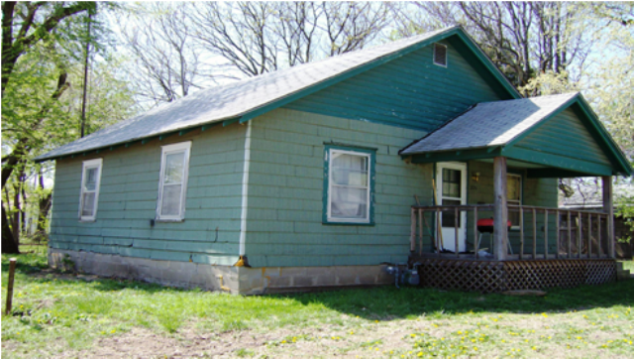
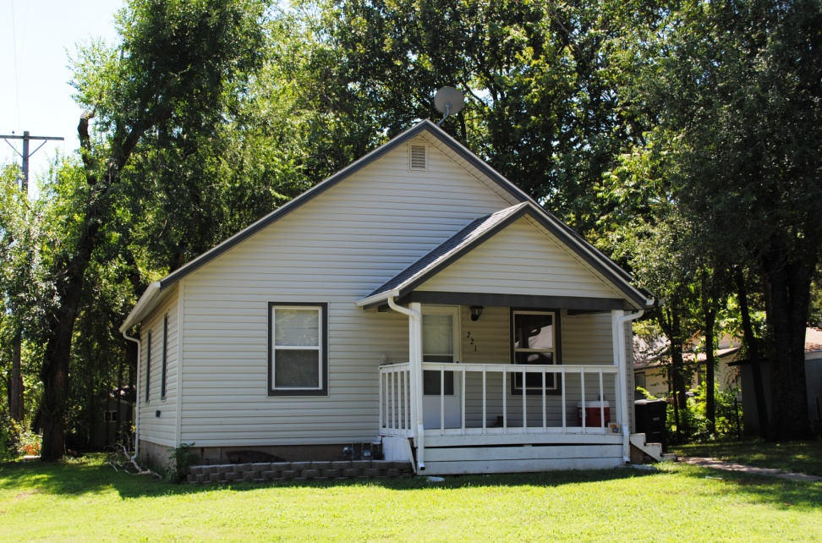
The CDBG program provides funding for comprehensive housing rehabilitation
Before
After
Homeowners, neighborhoods and communities benefit from the program

Slide 9
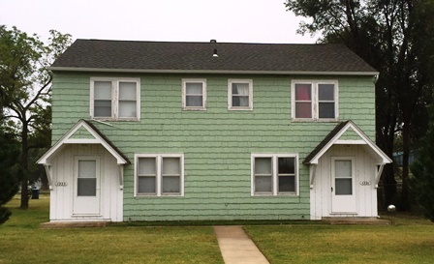
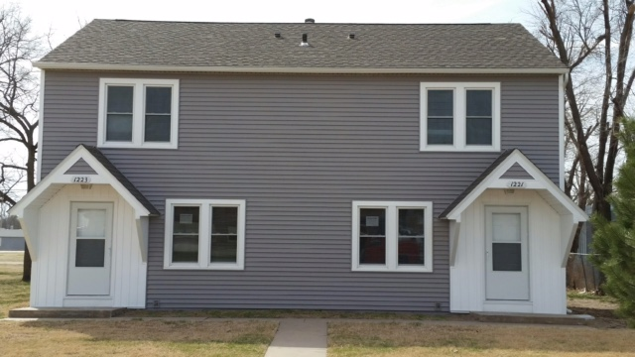
Multi-Family Project
Hutchinson Kansas
Rental Property

Slide 10
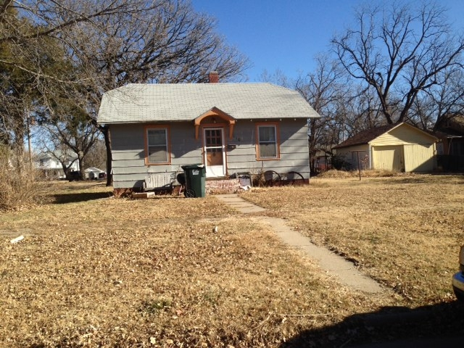
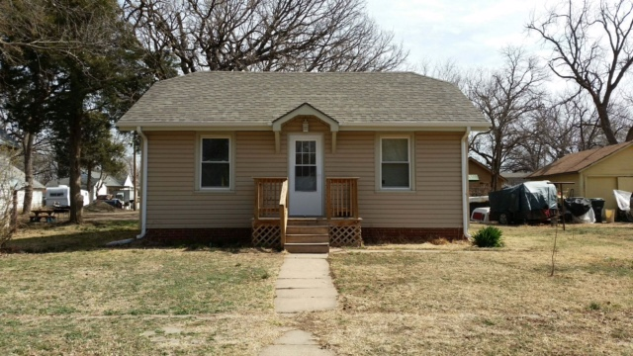
Lyons Kansas
Before:
After:

Slide 11
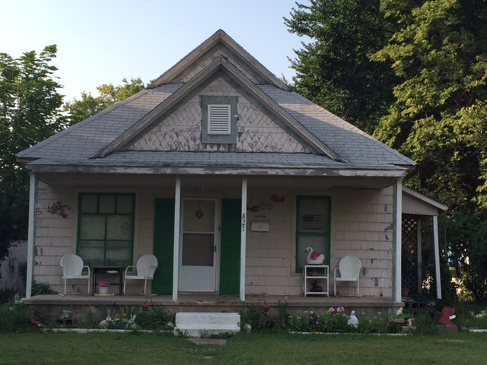
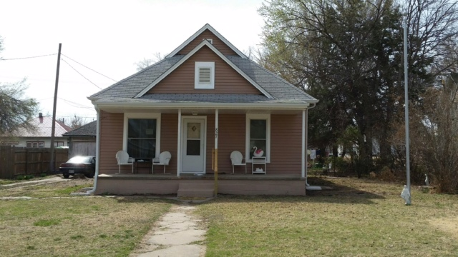
Hutchinson Kansas
Before:
After:

Slide 12
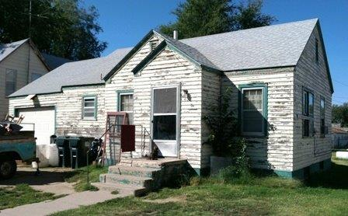
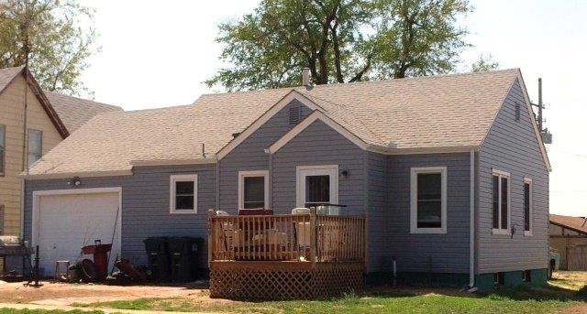
Home Improvements
Before
After

Slide 13
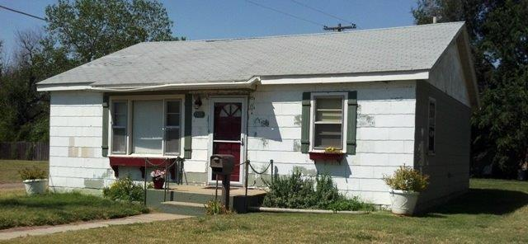
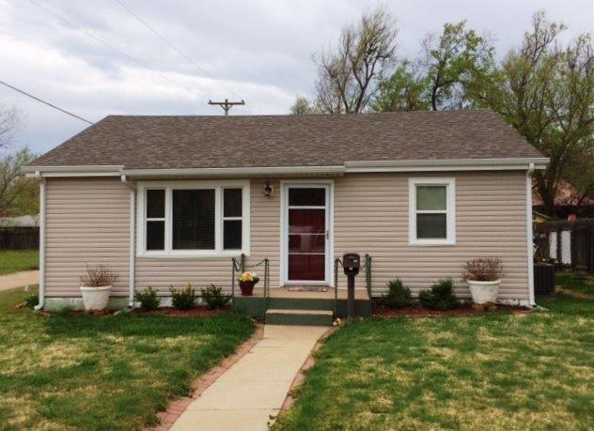
McPherson
Before
After

Slide 14
Contractor Information
We will do 16 comprehensive rehab projects in your community.
Project average should be around $23,200. This does not include any private funding sources.
The contract completion time for each project is 45 days.
The contractor is given an opportunity to visit each job site with an inspector to ask questions prior to the submission of bids. (Required)
All materials used directly on the project are tax exempt.
All licensees and permits are required, but permit fees will be waived by the community.
Payments for the project are made after completion of the project by the city and are made within 30 days or less.
All projects require a final inspections from local Building Officials and SCKEDD Housing Inspector. This includes a lead clearance.

Slide 15
Sample Work Order/Pricing (Pass out Sample work order)
Hand out of sample work order.
Explanation of expectations
Discussion
Q & A

Slide 16
Additional Services
Other funding sources and programs may be used on these projects.
Weatherization Services – This program may be available to some individuals who are being provided services by CDBG.
Allowable expenses may be: Repair or Replacement of heating system, installation of duct system, installation of mechanical ventilation, addition of insulation in attics, walls, and crawl spaces, air sealing measures and items that may be directly related to client health and safety.

Slide 17
Questions
Are there questions regarding the program?
We are committed to providing local contractors and businesses with an opportunity to learn an participate in the programs that are being offered in your community.

Slide 18
Contact Information
Jodi Suhler
Program Manager
Jodi@sckedd.org
Bill Lampe
Production Coordinator
blampe@sckedd.org
Mike Shivers
Housing Rehab Specialist
mshivers@sckedd.org
South Central Kansas Economic Development District
9730 E 50th street, Bel Aire, Kansas, 67226
(316) 262-7035 or www.sckedd.org

